Slide 1
Summer Opportunities for Ecology Undergrads
2014!
Info compiled by Justin Fischer
UNT SEEDS organization

Slide 2
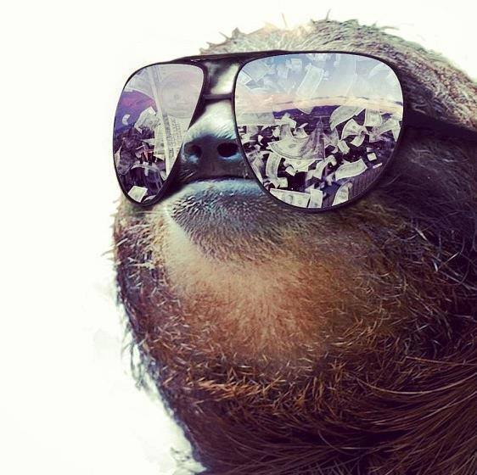
Tell me about yourself! ☺
When will you graduate?
Tentative career goals or grad plans?
Help me give you customized info

Slide 3
What can I do this summer?
Internships
Volunteer
Research Experience for Undergrads (REU)
All build connections and experience for your career and grad school!
What do you need for applications?

Slide 4
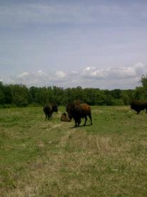
Internships
Hands-on technical skills, often an introduction to professional science
Outreach << great! Although a different experience than research
MIGHT earn money
Simple applications
- good letter of recommendation
- enthusiasm for your future career

Slide 5
Volunteer
Don’t limit your possibilities to just paid positions!
Volunteer experience shows that you have sincere passion and interest
Volunteer coordinators provide the !!!BEST!!! letters of recommendation
Check with UNT labs
…..sure helped me out a lot!

Slide 6
REU’s
= Research Experience for Undergraduates
Prestigious, competitive
With a mentor, investigate a scientific question over the summer with the ultimate goal of publishing academic-quality results
Often considered a means of guaranteed grad school acceptance
PLUS YOU GET PAID

Slide 7
REU’s- Rigorous Applications
2 or 3 excellent letters of rec
Beautiful essay
GPA > 3.0, higher the better

Slide 8
REU’s- Once you get there…
some programs have you shadow a researcher
Others, you are on your own
Deadlines!
No science = no paycheck
Could be the start of your career!

Slide 9
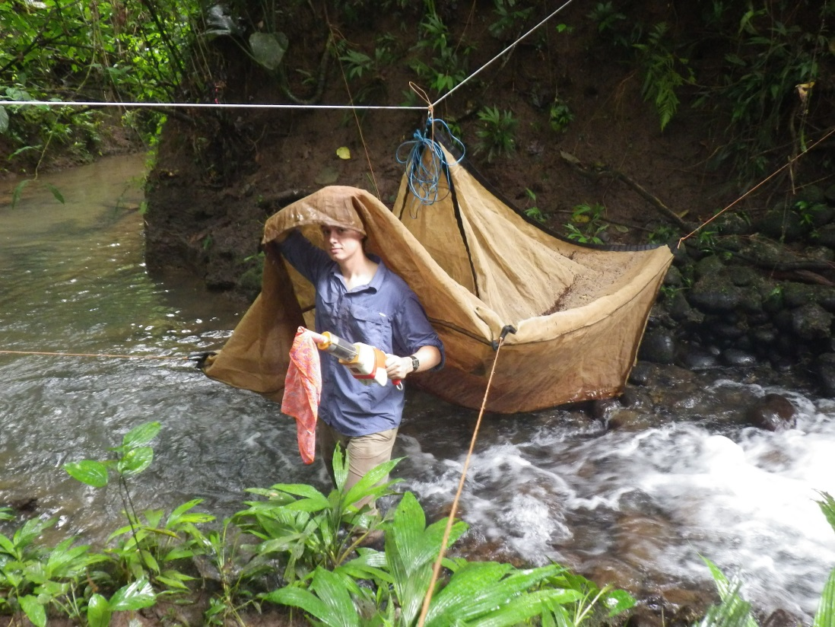
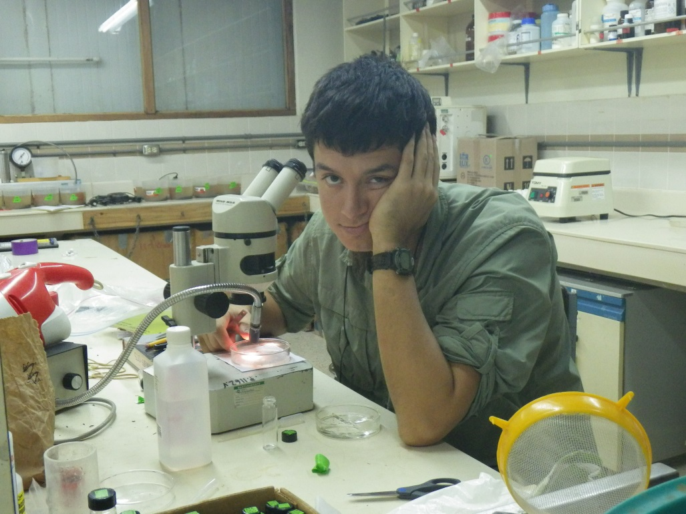
My last summer

Slide 10
What if all else fails?
Use your summer to deepen your knowledge of topics that interest you!
Example: take up bird watching or insect collecting, learn identification and ecology
Practice scientific literature comprehension
Volunteer

Slide 11
What to do now
Prioritize your favorite applications
Put the most effort into the ones that will further your career
Ask for letters of rec now! At least a week in advance
App deadlines for next summer are typically Jan-Mar

Slide 12
One perfect resource:
https://listserv.umd.edu/archives/ecolog-l.html
This listserv posts dozens of opportunities for undergrads and grad students, check often!

Slide 13
Contact Info??
Like us on Facebook SEEDS UNT Ecology and keep up with our website for direct links to summer 2014 internships and REU positions
SEEDSUNT.weebly.com
Don’t procrastinate!!! ☺

